Slide 1


CSC 458: Parallel and Distributed Systems Final Project
Parallel Video Compression using MPI
Suumil Roy (32378771)

Slide 2
Introduction
Video compression is the process of reducing size of a video file without degrading its quality.
Utilized to use less storage and bandwidth for efficiently transmitting videos in streaming, video conferencing, broadcasting digital TV

Slide 3
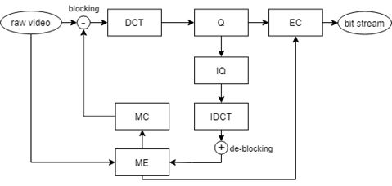
Video Compression Pipeline
DCT/IDCT : Direct Cosine Transform / Inverse Direct Cosine Transform
Q/IQ: Quantization / Inverse Quantization
ME/ MC: Motion Estimation/Motion Compensation
EC: Entropy Coding (Huffman)

Slide 4
Environment
Architecture: x86_64
CPU op-mode(s): 32-bit, 64-bit
Byte Order: Little Endian
CPU(s): 4
On-line CPU(s) list: 0-3
Thread(s) per core: 1
Core(s) per socket: 4
Socket(s): 1
Vendor ID: GenuineIntel
CPU family: 6
Model: 58
Model name: Intel(R) Core(TM) i5-7500 CPU @ 3.40GHz

Slide 5
Experiment #1
Setup: Simple Video Compression vs Parallel Video Compression
Input : 126 MB Raw Video Stream
Simple Video Compression: Utilizes OpenCV's VideoWriter to compress to desired format.
Parallel Video Compression: Splits Video Stream into chunks defined by the number of processors specified to MPI. Utilizes OpenCV's VideoWriter to compress each chunk independently.
Experiments:
Simple vs Parallel (2 processors): Speedup = 33.99/20.64 = 1.64
Simple vs Parallel (3 processors): Speedup = 33.99/26.05 = 1.30
Simple vs Parallel (4 processors): Speedup = 33.99/21.87 = 1.554

Slide 6
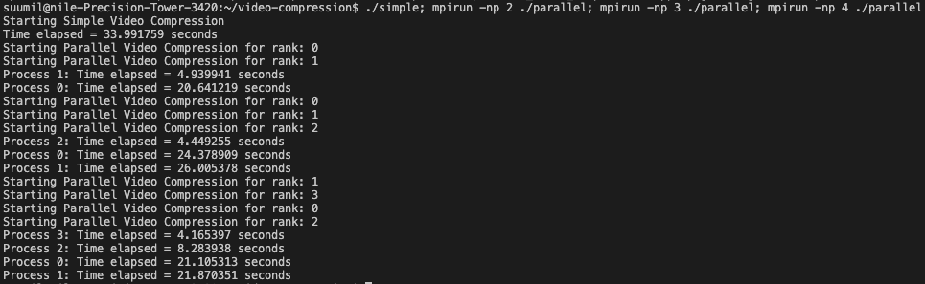
Results – Experiment #1

Slide 7
Experiment #2
Setup: Vanilla Video Compression vs Distributed Video Compression
Input : 126 MB Raw Video Stream
Vanilla Video Compression: Custom Implementation of Video Compression using the stages: discrete cosine transform->quantization->inverse quantization-> inverse discrete cosine transform
Distributed Video Compression: Interframe Compression for the above implementation achieved by using OpenMP.
Experiments:
Simple vs Parallel (2 threads): Speedup = 138.20/78.76 = 1.75
Simple vs Parallel (4 threads): Speedup = 138.20/64.49 = 2.14
Simple vs Parallel (8 threads): Speedup = 138.20/54.54 = 2.53

Slide 8
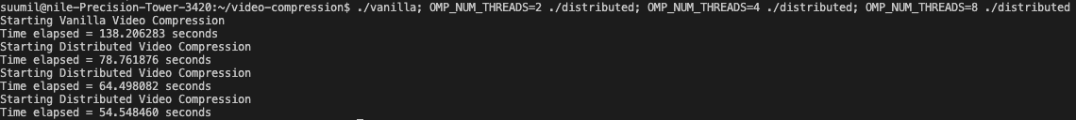
Results – Experiment #2

